Slide 1
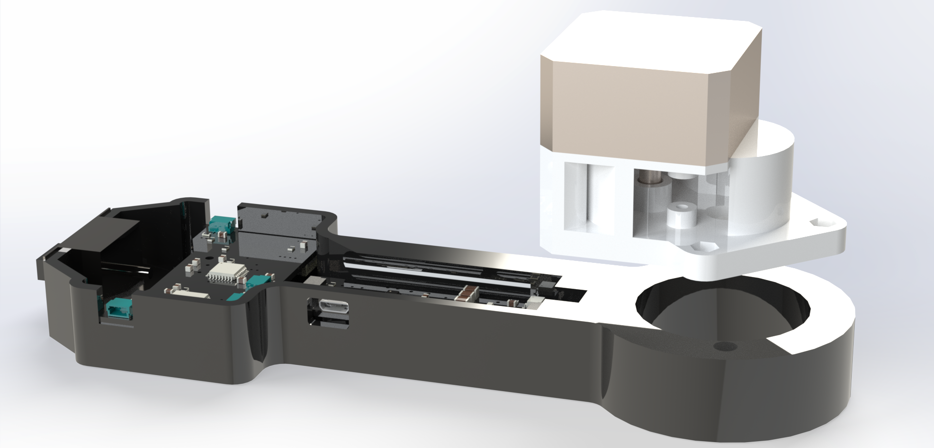
ECE477 Midterm Design Review: Team 6
Notes:
[Matthew]

Slide 2
Outline
Project Overview
Major Components
Block Diagram
Packaging Design
HBmS Schematic and Layout
DAqS Schematic and Layout
Prototyping Progress
Software Development Status
Project Timeline
Questions
Notes:
[Matthew]

Slide 3
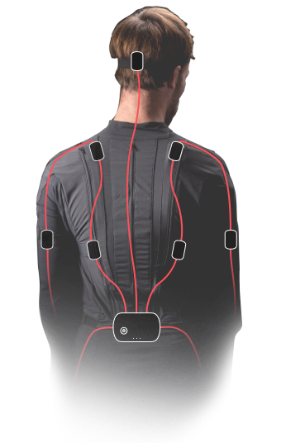
Project Overview
Revex: A non-optical VR tracking Solution
Better Immersion
Immune to occlusion
Less obstruction
Haptic Feedback
More Affordable
Cheaper materials
Fewer sensors
More Efficient
Low-power, BLE
Energy Harvesting
Rokoko Motion Capture Suit
https://www.rokoko.com/products/smartsuit-pro
Notes:
[Matthew]

Slide 4
PSSCS
Project Specific Success Criteria
PSSC #1: Ability to read accelerometer and gyroscope data from an inertial measurement unit (IMU).
PSSC #2: Ability to read voltage from an analog potentiometer to infer elbow joint angle using an Analog-Digital Converter (ADC).
PSSC #3: Ability to transceive raw sensor data and haptic feedback intensity value bi-directionally between the wearable device and host computer via Bluetooth Low Energy (BLE).
PSSC #4: Ability to provide passive haptic feedback on an elbow joint by variably shorting motor coils.
PSSC #5: Ability to estimate arm position in a virtual reality (VR) simulation on the host computer by fusing acceleration, gyroscope, and VR headset position/orientation.
Notes:
[Zach]
At a high level, revex will read IMU and analog pot data, send that over Bluetooth to a host computer where will determine haptic feedback that should be applied to the elbow joint based on the users estimated arm position

Slide 5
Major Components
Notes:
[Zach]

Slide 6
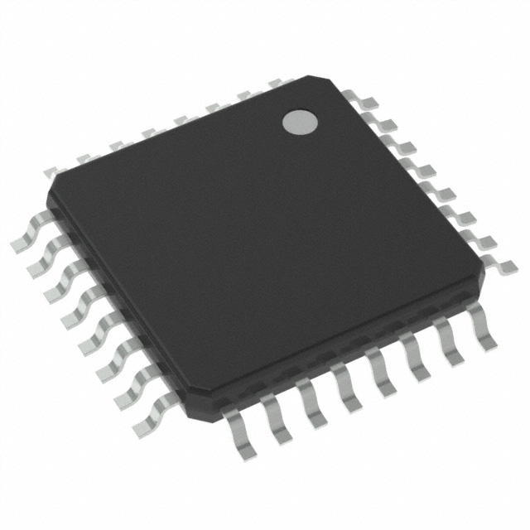
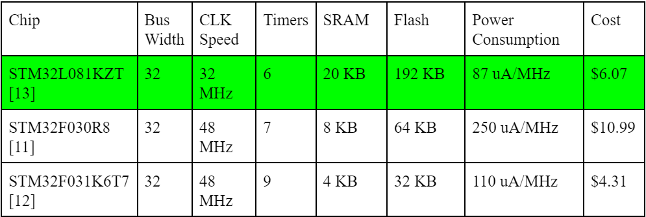
Major Components
Microcontroller
Possible Options
STM32L081KZT
STM32F030R8
STM32F031K6T7
Selected Choice
STM32L081KZT
Reasoning for Choice
Low-power
Large Flash
Pin Count
Available Features
Required Supply Voltage
Notes:
[Zach] The primary selection criteria were familiarity with device, low powered, pin count, and flash storage. STM32 chips were primarily considered for development familiarity. Each of these chips offers 2 I2C lines, a SPI, and at least 2 USARTs. Additionally, each chip should have enough space to host thr program data and the two lookup tables – one that map analog potentiometer voltage output -> elbow angle and haptic feedback intensity -> PWM frequency; however, only two chips are low powered, and the STM32L081KZ has ample storage space for any other possible improvements.

Slide 7
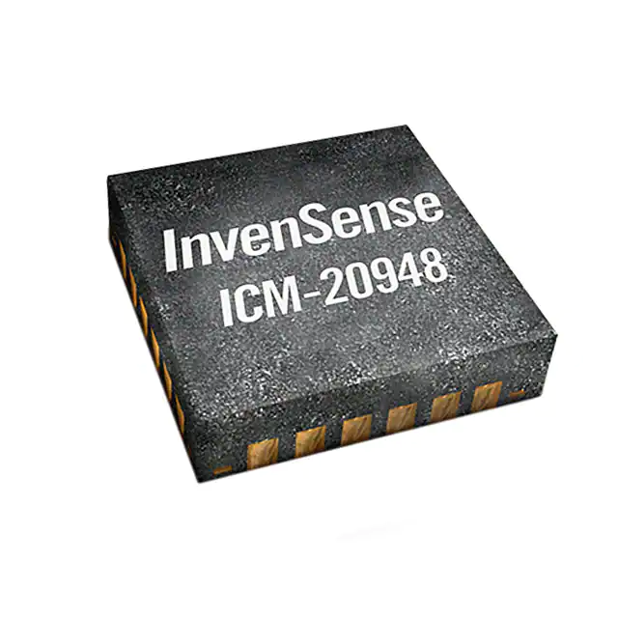
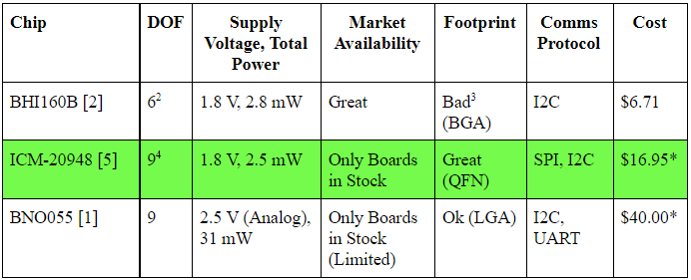
Major Components
Inertial Measurement Unit
Possible Options
BHI160B
ICM-20948
BNO055
Selected Choice
ICM-20948
Reasoning for Choice
Availability
Low-power
SPI/High Frequency Sampling
Footprint
Supply Voltage
9DOF (Magnetometer)
Notes:
[Zach] The primary selection criteria for this chip is listed below. The most critcal being supply voltage, low-power consumption and sampling frequency. The BNO chip did not meet the meet the 1.8 V supply voltage criteria. While the BHI chip was perfect in almost all specs, its footprint made it infeasible to solder onto our PCB given our resources. The ICM chip met all criteria we listed here, the only downsides of this chip is needing to desolder it from a breakout board and it does not have easy integrated sensor fusion; hence, we are offloading sensor fusion to the host computer.

Slide 8
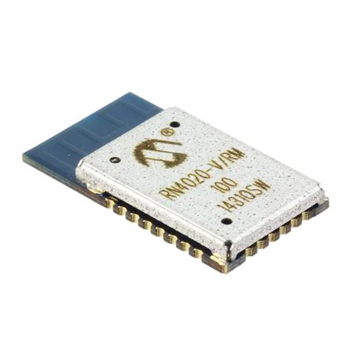
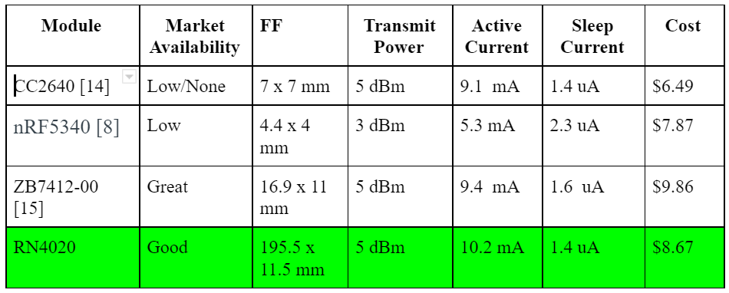
Major Components
Bluetooth Module
Possible Options
CC2640
RN4020
7B7412-00
Selected Choice
RN4020
Reasoning for Choice
Availability
Documentation
Low Powered
MLDP Mode
Notes:
[Isaac]

Slide 9
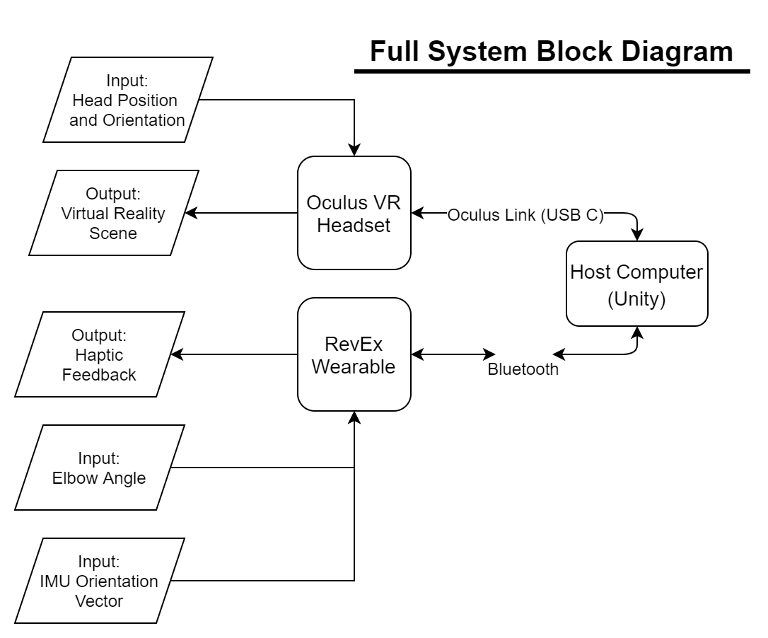
Block Diagram
Full System
Notes:
[Matthew]

Slide 10
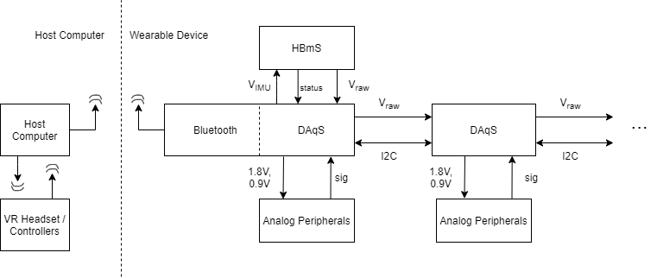
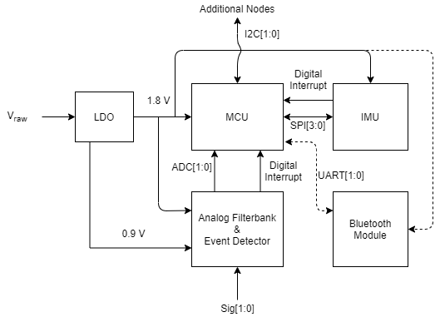
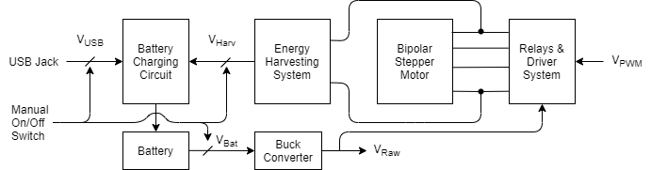
Block Diagram
Hardware
Internodal Signal/Energy Flow
Data Acquisition System (DAqS)
Haptics and Battery-management System (HBmS)
Notes:
[Swagat]

Slide 11
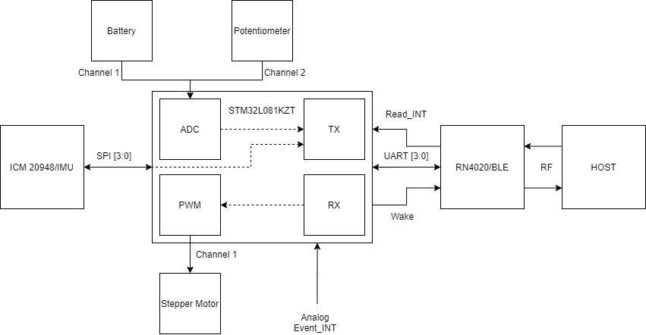
Block Diagram
Embedded Software
Notes:
[Isaac]

Slide 12
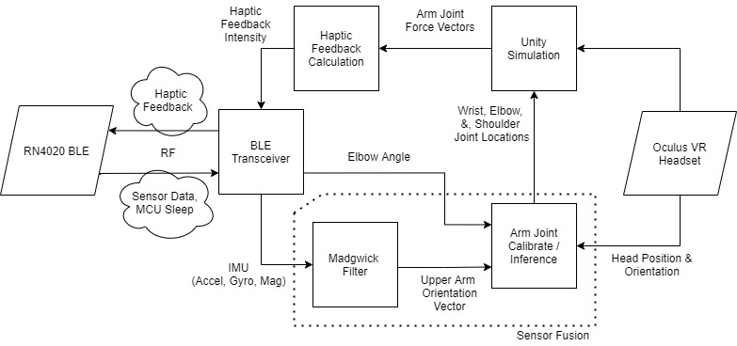
Block Diagram
Host Software
…
Notes:
[Zach] The block diagram for the host computer picks up from the MCU diagram at the BLE chip. The primary packet sent from the MCU to the host are sensor packets containing elbow angle and the 9DOF IMU data. This data alongside the head position from the VR headset is sent as input into the sensor fusion subsystem. This is composed of a madgwick filter that produces an orientation vector of the upper arm from the IMU data before fusing that wit the other sensor data in order to infer the locations of the shoulder, elbow, and wrist joints relative to the VR headset in the world space. This joint location information is used to render the users arm along with other objects the user can interact with in VR. Based off the user’s interactions, a haptic feedback intensity value is calculated and sent back to the MCU over BLE.

Slide 13
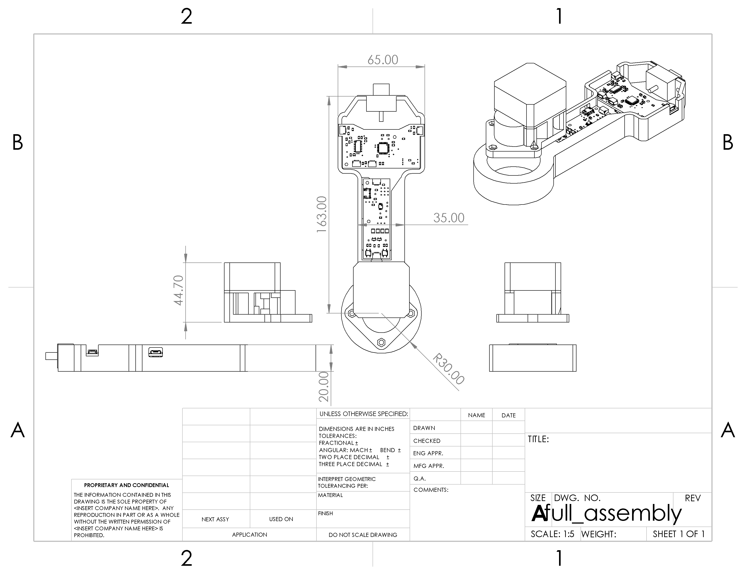
Packaging Design
Notes:
[Matthew]

Slide 14
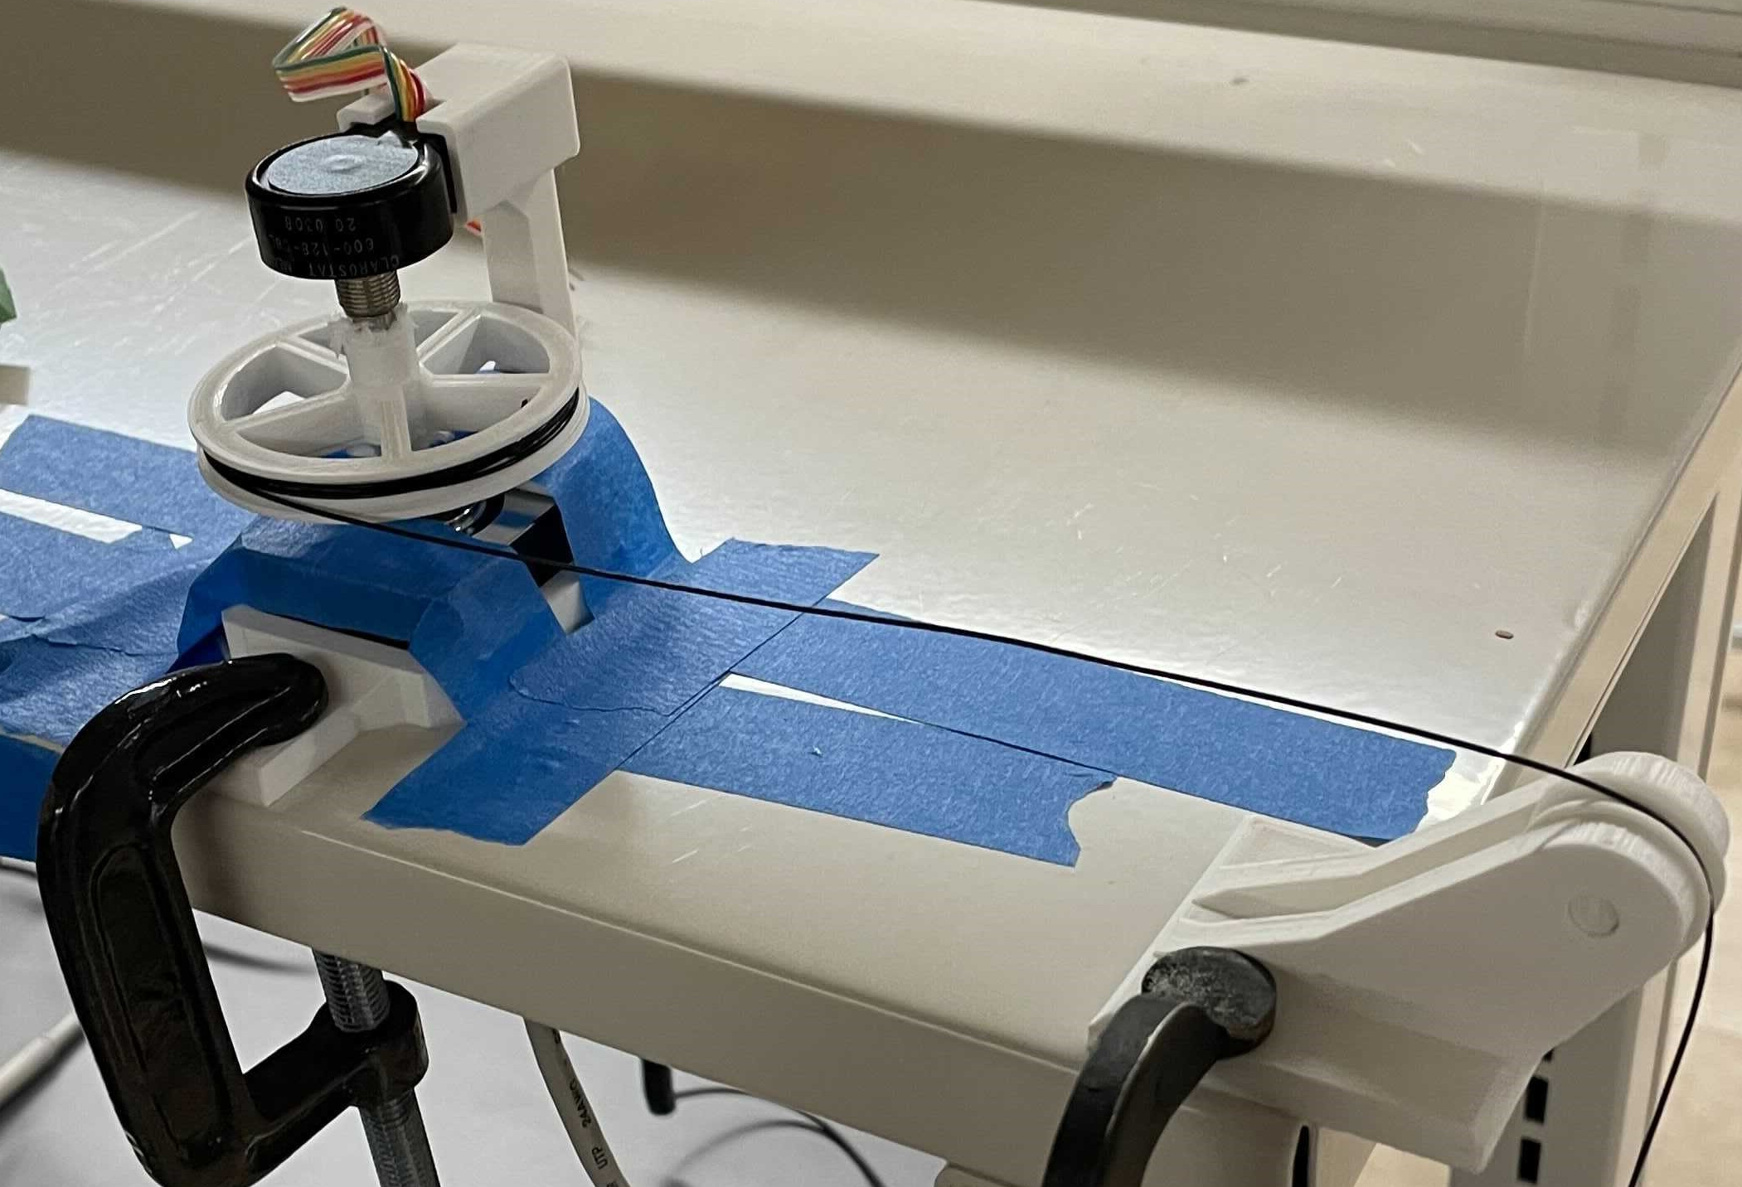
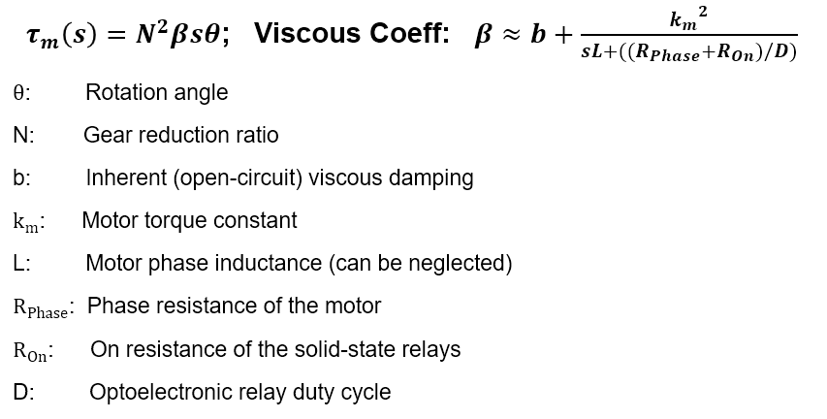
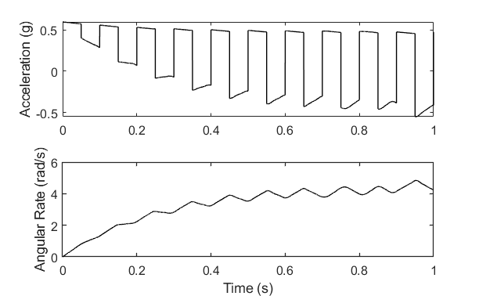
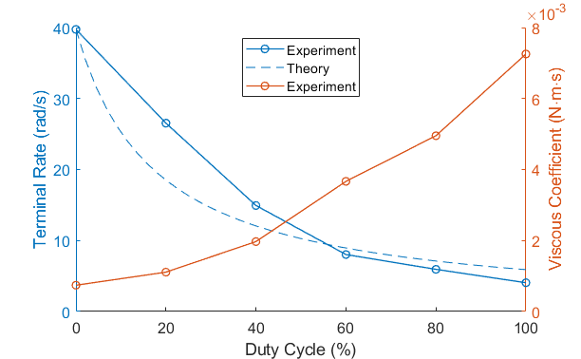
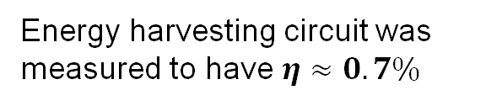
HBmS Theory
Energy harvesting circuit was measured to have $η≈0.7\%$
Saturation due to 2.2 mW power limit
Notes:
[Swagat]

Slide 15
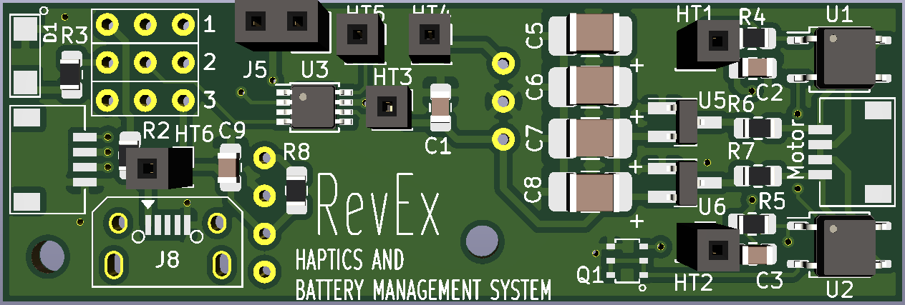
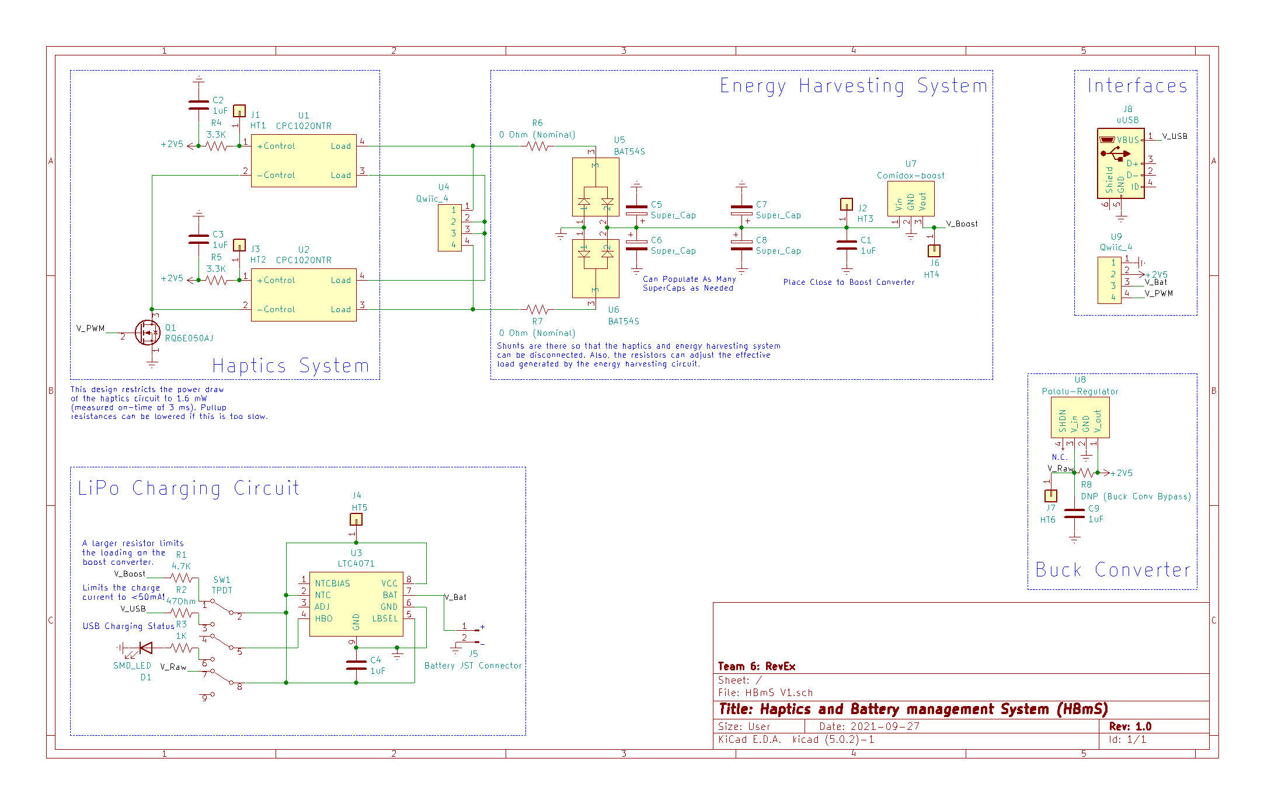
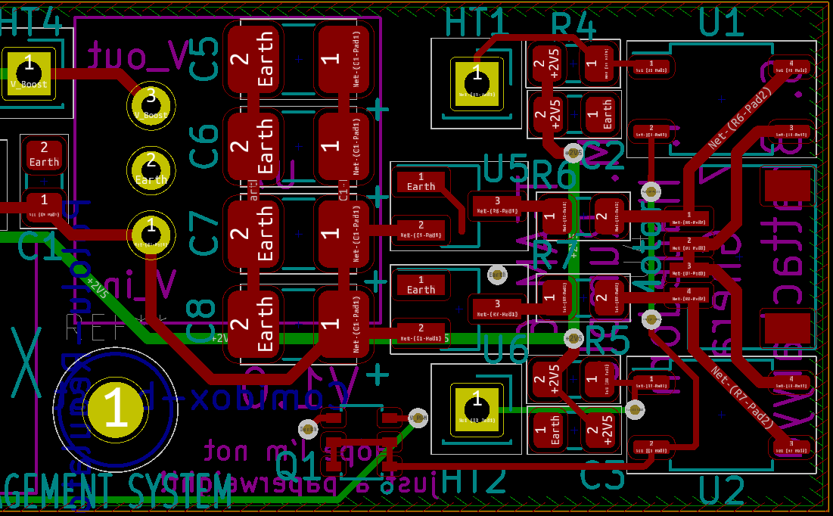
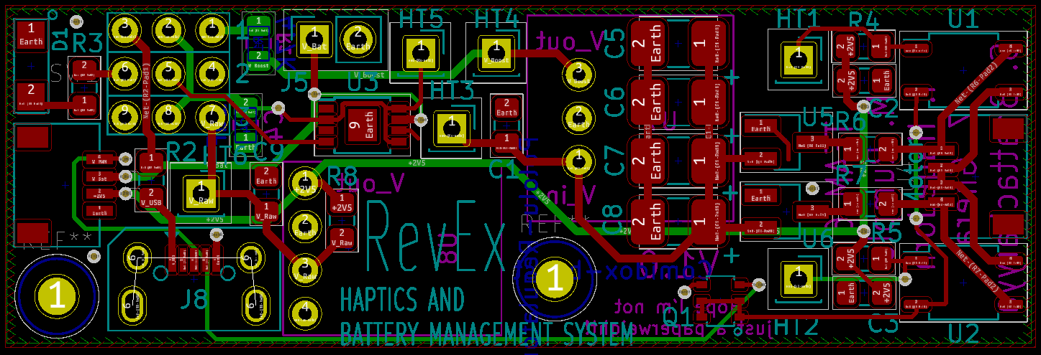
HBMS Schematic & LayOut
Haptics and energy harvesting System
Notes:
[Swagat]

Slide 16
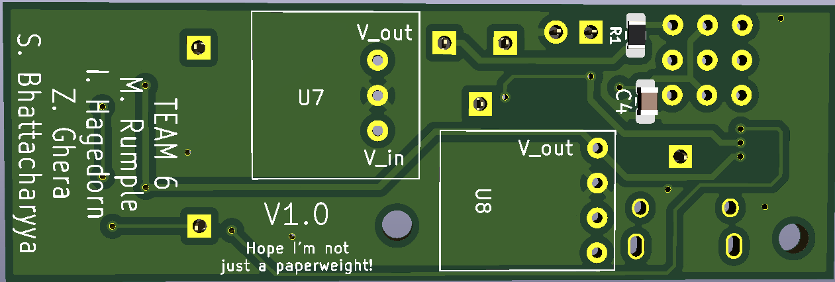
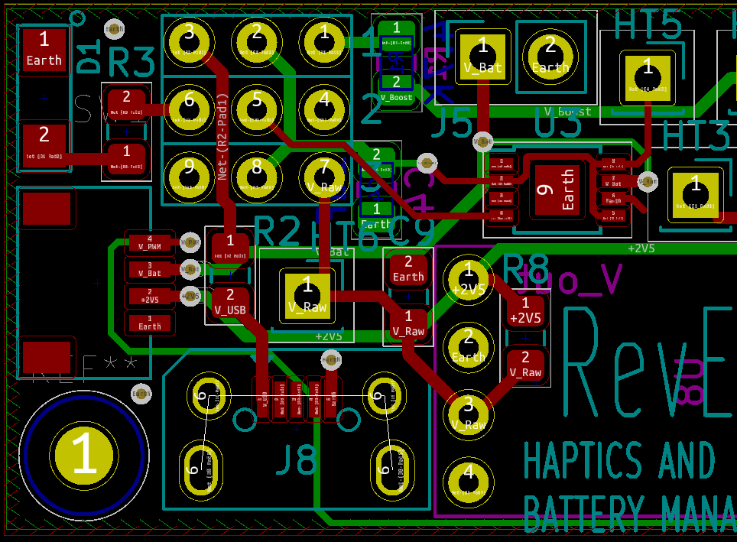
HBMS Schematic & LayOut
Battery Management, Interfaces, Buck Converter
Mechanical switch for simplicity in the first iteration. This may change.
Buck Converter will reduce the TDP of the LDO by ~2.4x
Notes:
[Swagat]

Slide 17
HBMS: A Reality Check
Issues encountered so far with hBms…
Have populated & began HBmS testing
Serves as footprint verification…
Energy harvesting circuit can create unintentional haptic feedback
Can be mitigated by tuning R6, R7
LiPo charger is displaying strange behavior
Our chip isolates the battery
VDD and V_Bat on the LTC4071 must be momentarily connected on startup (they will then remain connected)
Our stepper motor now skips when we apply haptic feedback
Possible lubricant leak?
Plan to replace motor and do failure analysis
Notes:
[Swagat]

Slide 18
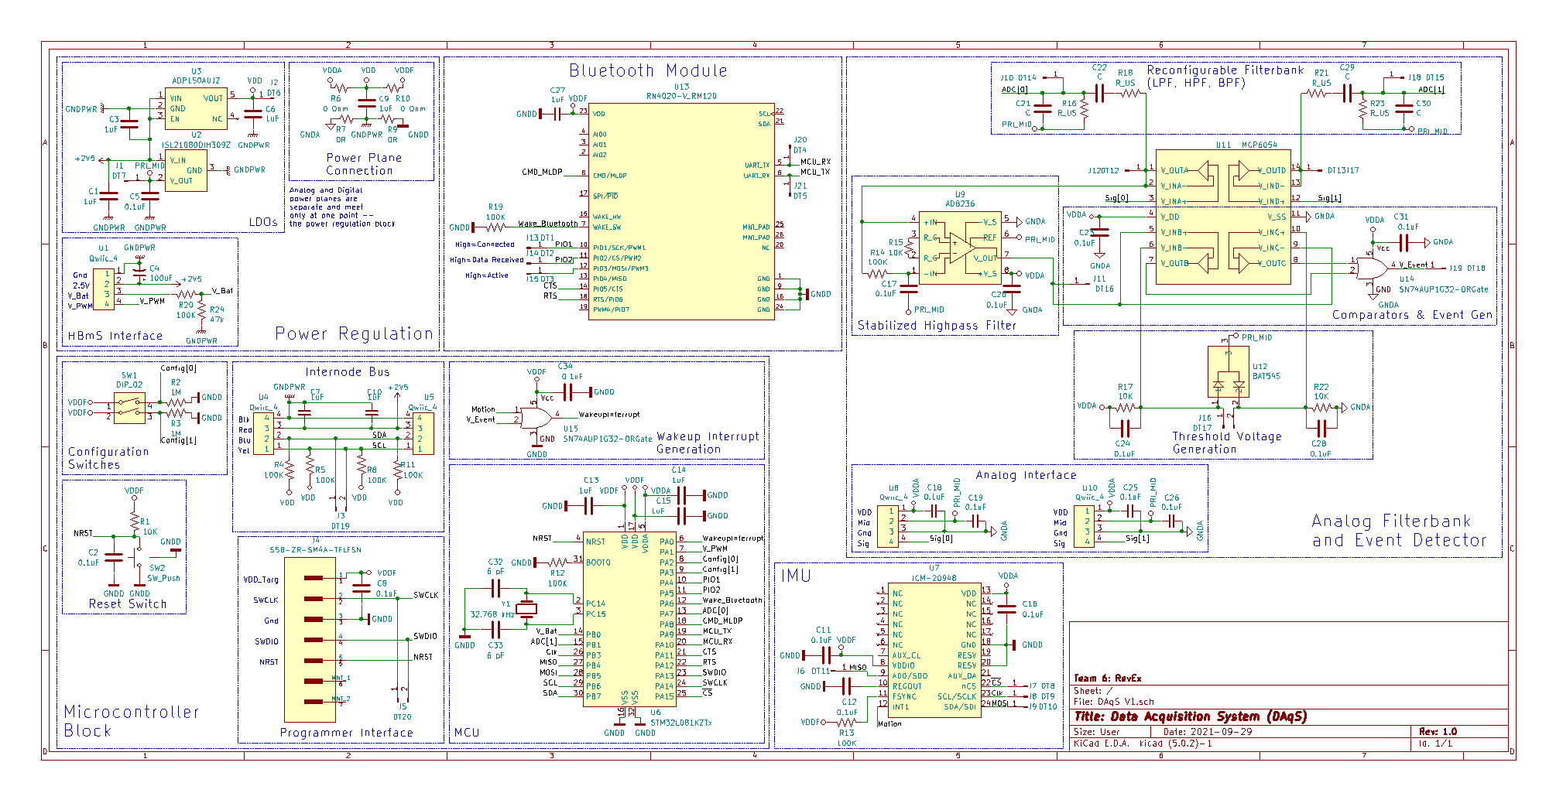
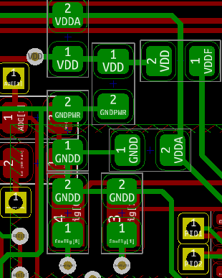
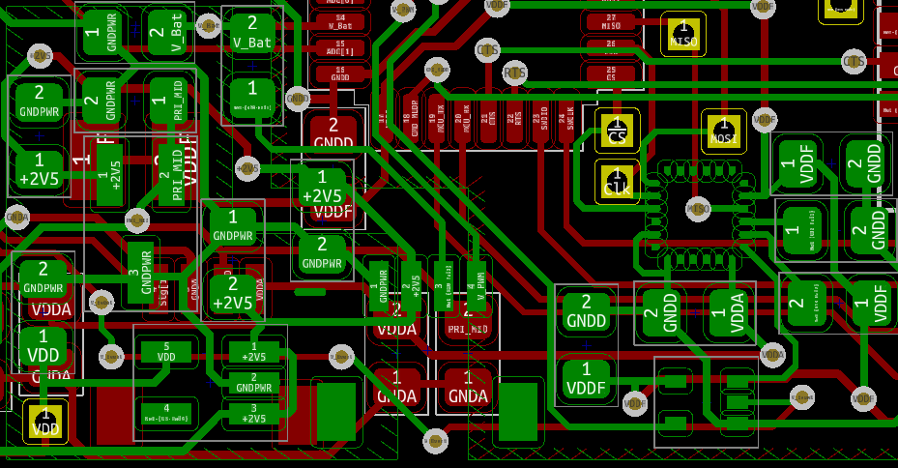
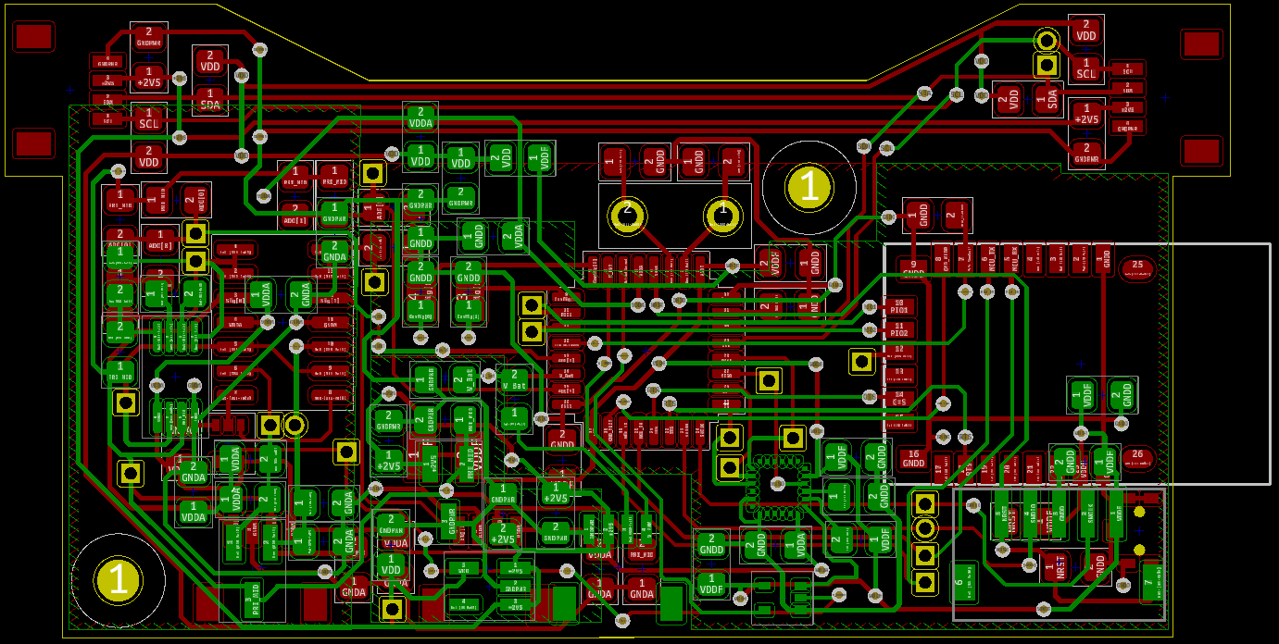
DAqS Schematic & LayOut
Power Regulation and IMU
Notes:
[Matthew]

Slide 19
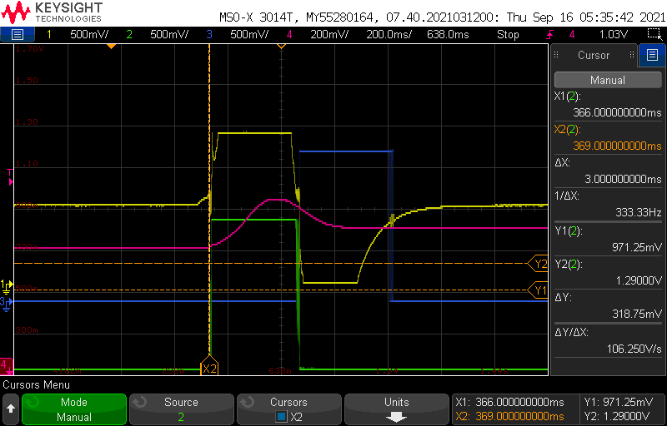
DAqS Schematic & LayOut
Low-power Analog Filterbank and Event Detector
HPF Out
Input
Comparator 2
Comparator 1
Highly-reconfigurable topology with tunable sensitivity
Power Draw: 1.1 mW (Including LDO)
Latency From Event Onset to Interrupt Output: 3 ms
Notes:
[Swagat]

Slide 20
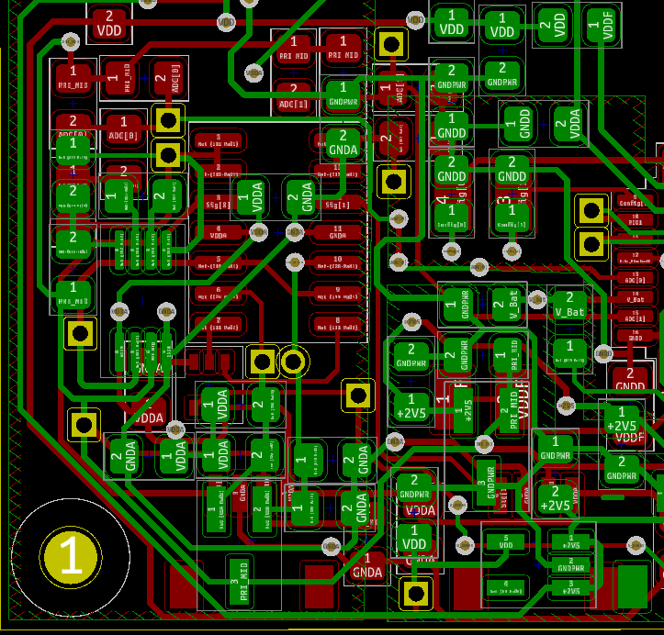
DAqS Schematic & LayOut
Low-power Analog Filterbank and Event Detector
Notes:
[Swagat]

Slide 21
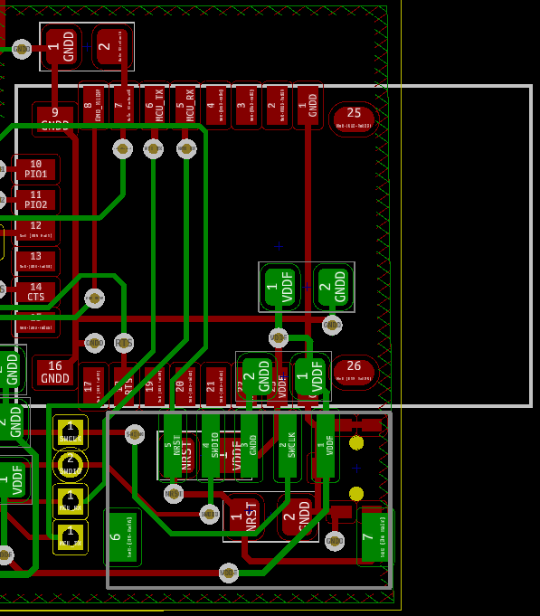
DAqS Schematic & LayOut
Bluetooth Module and Some Microcontroller Peripherals
Notes:
[Isaac]

Slide 22
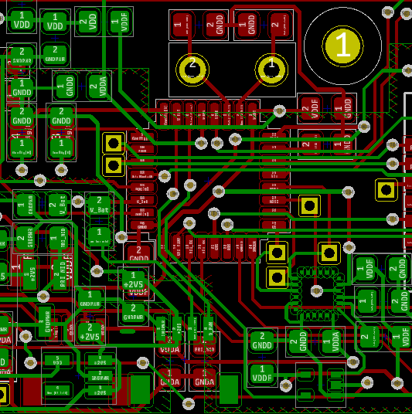
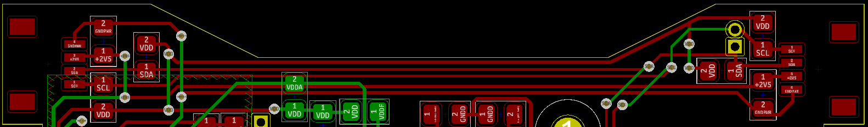
DAqS Schematic & LayOut
Microcontroller and Microcontroller peripherals
Notes:
[Matthew and/or Isaac]

Slide 23
Prototyping Progress
Hardware (Electrical)
HBmS Systems:
Haptic Feedback: Complete
Energy Harvesting: Complete
Buck Regulation: Complete
Battery Charging: In Testing
Integration: In Testing
DAqS Systems:
Analog Event Detector: Complete
IMU: Complete
Power Regulation: Complete
Bluetooth: In Progress
Potentiometer Breakout: In Progress
Integration: Not Started
Microcontroller Peripherals & Internode Bus: Not Started

Slide 24
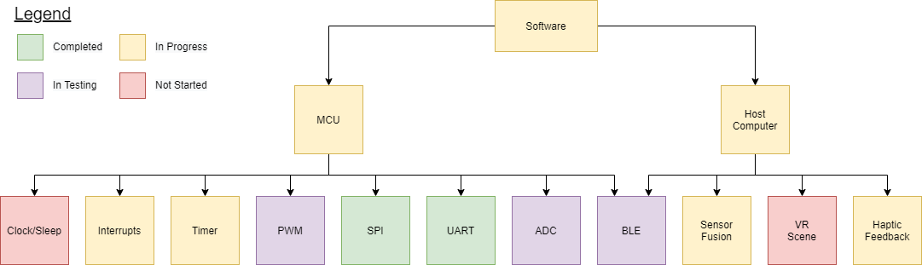
SOFTWARE DEVELOPMENT STATUS
Software
Notes:
[Zach] Now we will go over the development status and the associated prototyping progress of the software components of RevEx. As pictured here, software is comprised of the embedded code that lives on our MCU as well as the host computer software. These are connected by a BLE interface.

Slide 25
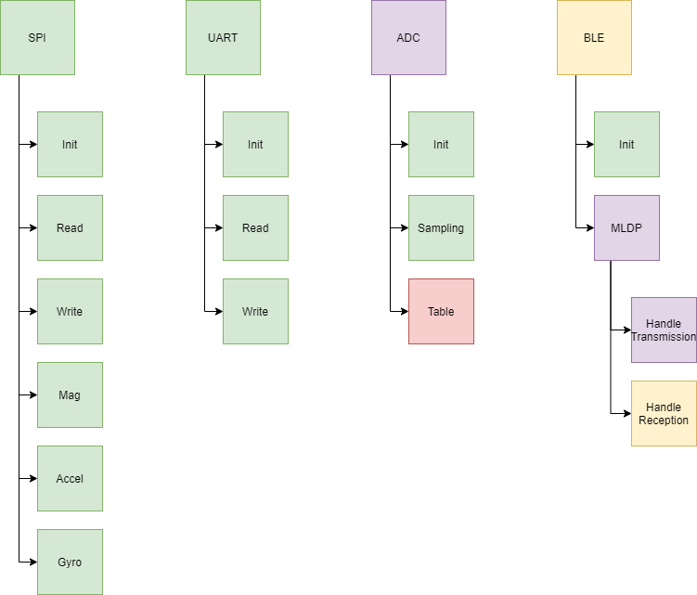
SOFTWARE DEVELOPMENT STATUS
Embedded Software

Slide 26
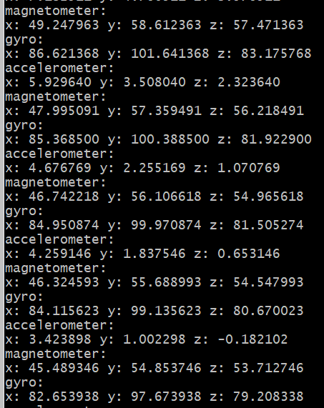
Prototyping Progress
Embedded Software
IMU output over SPI on terminal via UART
Notes:
[Isaac]

Slide 27
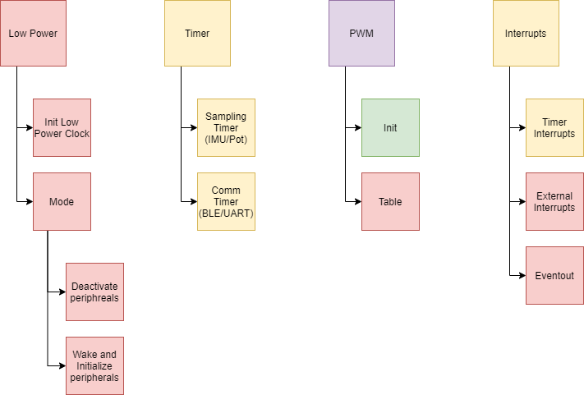
SOFTWARE DEVELOPMENT STATUS
Embedded Software

Slide 28
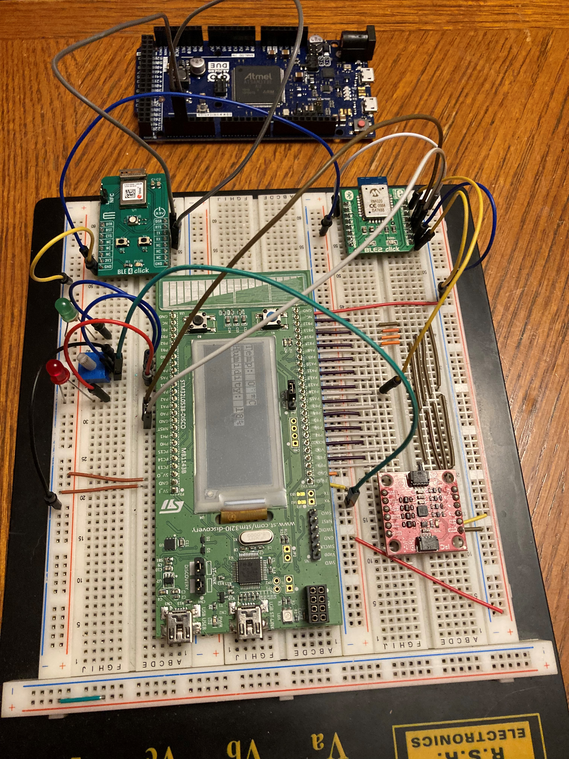
Prototyping Progress
Embedded Software
Full breadboard layout for timer/interrupt integration
Notes:
[Isaac]

Slide 29
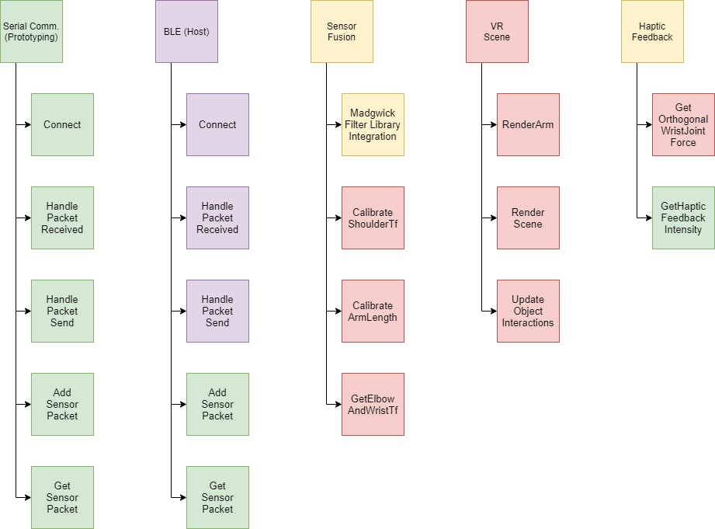
SOFTWARE DEVELOPMENT STATUS
Host Software
Notes:
[Zach]
----
CalibrateShoulderTf: Instruct the user to move their arm in an arc from one specific position to another while holding the controller. Sample three points along the arc and obtain the perpendicular bisector of points one and two as well as from point two and three. The shoulder position is then the intersection of these lines. Return a Unity Transform corresponding to this 3D point.
CalibrateArmLengthsInstruct the user to fully extend their arm such that we can find the total distance from the shoulder tf to the hand (controller). Then we can get the position of the elbow using the same intersection technique used in CalibrateShoulderTf. Once we have the elbow transform and total arm length, we can get the forearm length by subtracting the upper arm length (distance from should to elbow) from the total arm length.
*GetElbowAndWristTfsUse the shoulder position, orientation (roll, pitch, yaw) vector from the Madgwick filter, and the upper arm length to infer the elbow position. This elbow position is fused with the elbow angle received in the data packet and the forearm length to infer the wrist position. The corresponding elbow and wrist transforms are returned.
----
Haptic: Based on the max torque the haptic feedback system can apply (Tmax), we can determine this value with feedback_intensity =min(255,(dforearm|F|)||Tmax||) where dforearmand Fand are the length of the user’s forearm and the orthogonal wrist joint force that can be determined by the physics engine in the VR toolbox.

Slide 30
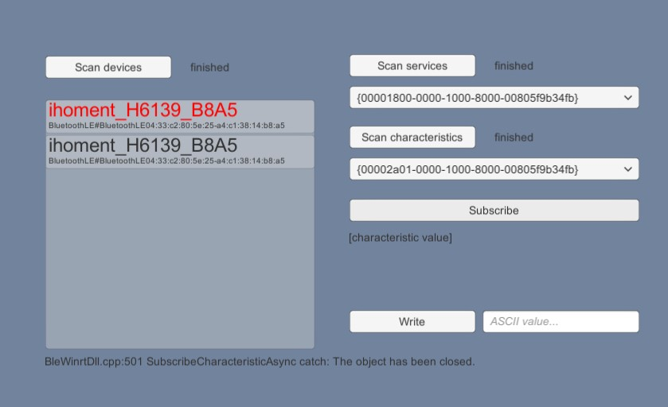
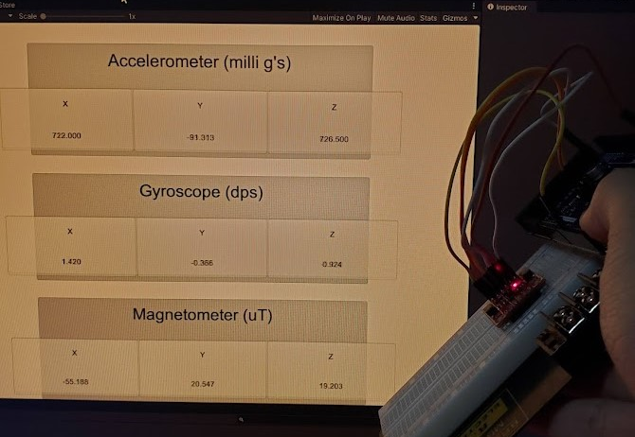
Prototyping Progress
Host Software
Windows BLE DLL for Unity
Serial Reader (IMU) and
Unity Display
Madgwick Filter DLL
Notes:
[Zach]

Slide 31
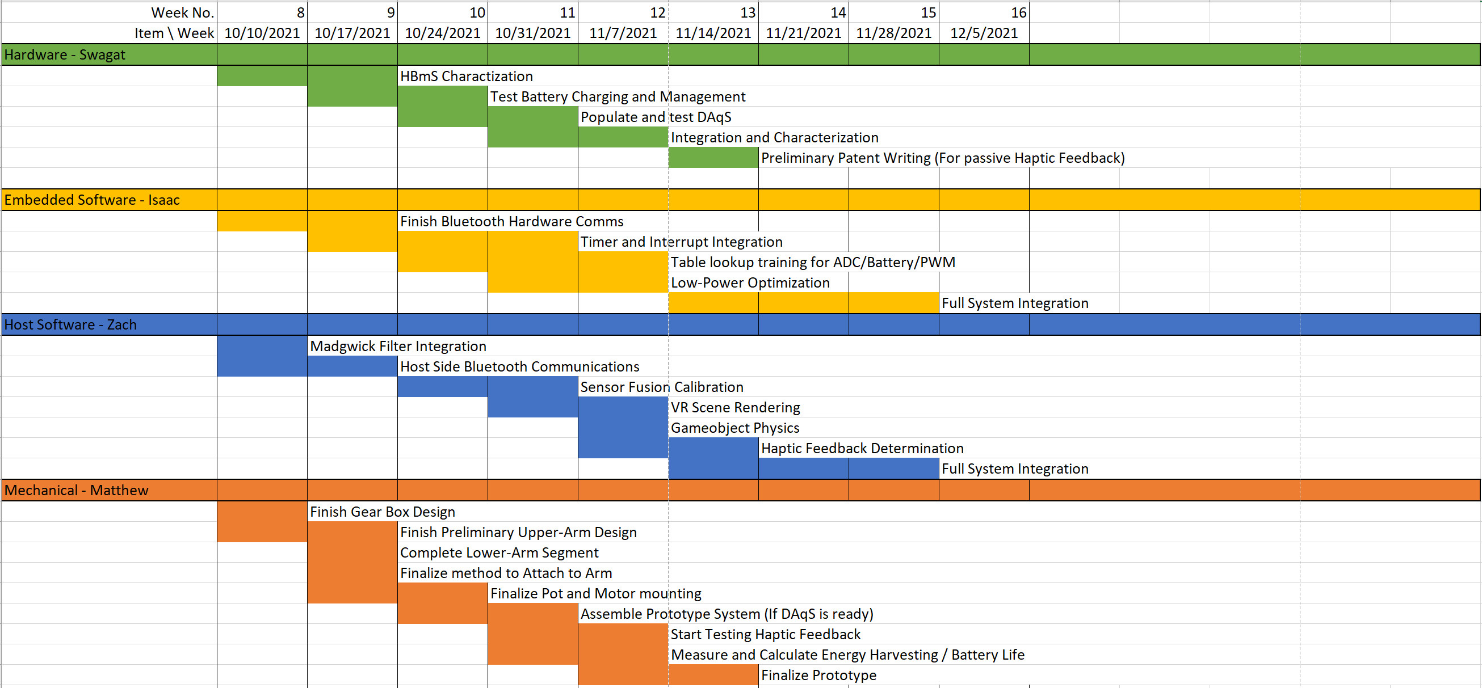
Project Timeline
Notes:
[Matthew]

Slide 32
3D Printing
Questions?

